Slide 1
Generative vs Discriminative Models

Slide 2
Learning Outcomes
Understand and Apply Basic Photo Enhancements: Students will learn to perform essential photo enhancements, such as brightening and adding vibrancy to specific elements like eyes in a portrait, using Adobe Photoshop. This outcome ensures they can elevate the quality of digital images through subtle but effective edits.
Learn the Technique of Posterization: Students will gain proficiency in posterizing images to create a vintage or stylized effect by reducing the number of colors and adjusting brightness levels. This outcome focuses on helping students understand how to manipulate images creatively while maintaining control over the final aesthetic.
Develop Skills in Layer Management and Masking: Students will learn how to organize their Photoshop projects using layers and apply effects selectively through layer masks. This outcome ensures students can manage complex edits effectively and refine their work to achieve professional-quality results.

Slide 3
Generative Models
Discriminative Models

Slide 4
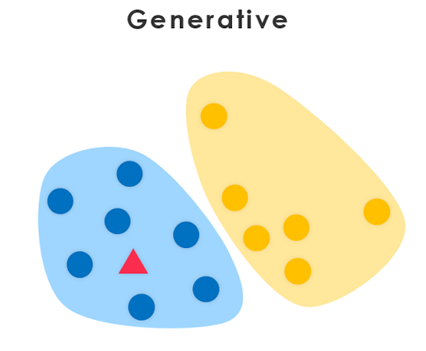
Generative Models
Generative models are machine learning models that learn to generate new data samples similar to the training data they were trained on.
They capture the underlying distribution of the data and can produce novel instances

Slide 5
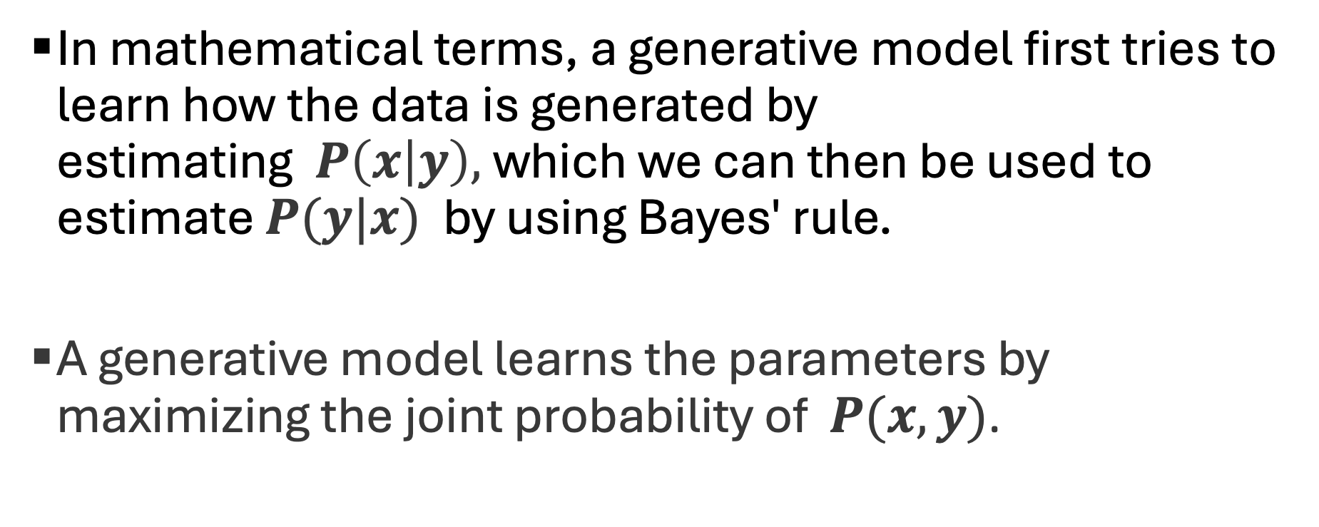
The Math of Generative Models
In mathematical terms, a generative model first tries to learn how the data is generated by estimating $P\left(x | y\right),$which we can then be used to estimate $P(y|x)$ by using Bayes' rule.
A generative model learns the parameters by maximizing the joint probability of $P(x,y)$.

Slide 6
Examples of Generative Models
Naïve Bayes
Hidden Markov Models (covered in Reinforcement Learning)
Generative Adversarial Networks (covered in Deep Learning)

Slide 7

Generative Models
Discriminative Models

Slide 8
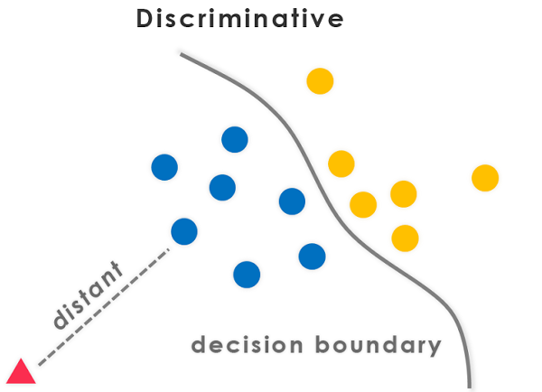
Discriminative Models
Discriminative models focus on modeling the decision boundary between classes in a classification problem.
The goal is to learn a function that maps inputs to binary outputs, indicating the class label of the input.

Slide 9
Discriminative Models
Discriminative models separate classes instead of modeling the conditional probability and don’t make any assumptions about the data points.

Slide 10
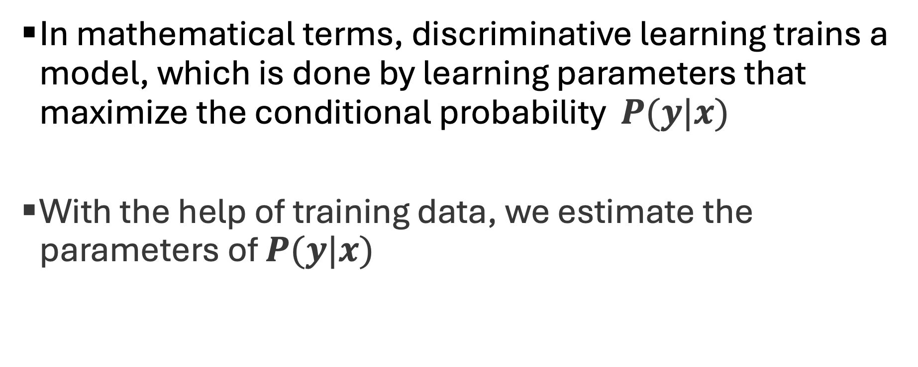
The Math Behind Discriminative Models
In mathematical terms, discriminative learning trains a model, which is done by learning parameters that maximize the conditional probability $P(y|x)$
With the help of training data, we estimate the parameters of $P(y|x)$

Slide 11
Examples of Discriminative Models
Support vector machines(SVMs)
‌Neural networks
‌K-Nearest neighbor
Decision Trees and Random Forest

Slide 12
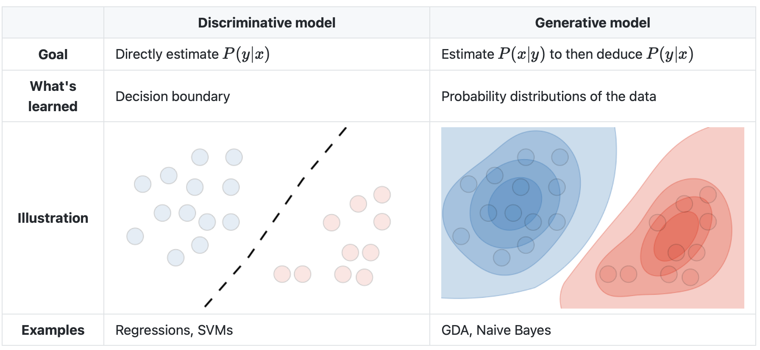

Slide 13
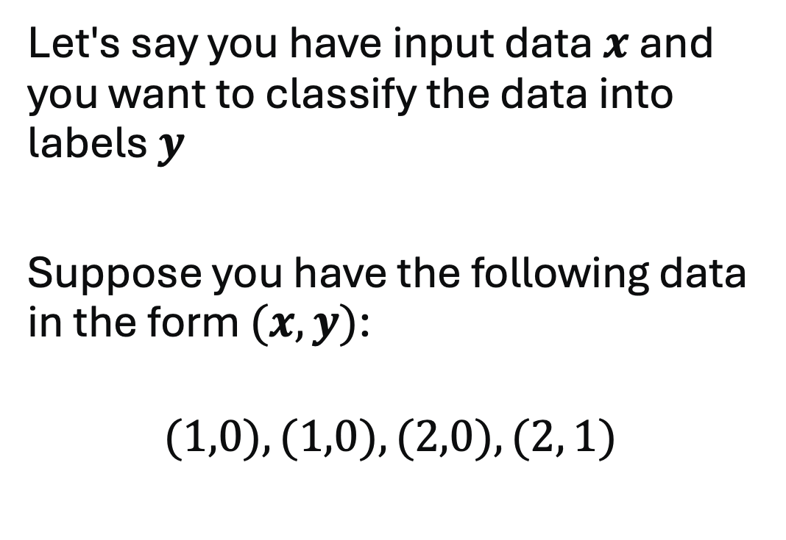
Example
Let's say you have input data $x$ and you want to classify the data into labels $y$
Suppose you have the following data in the form $(x,y)$:
$$(1,0), (1,0), (2,0), (2, 1)$$

Slide 14
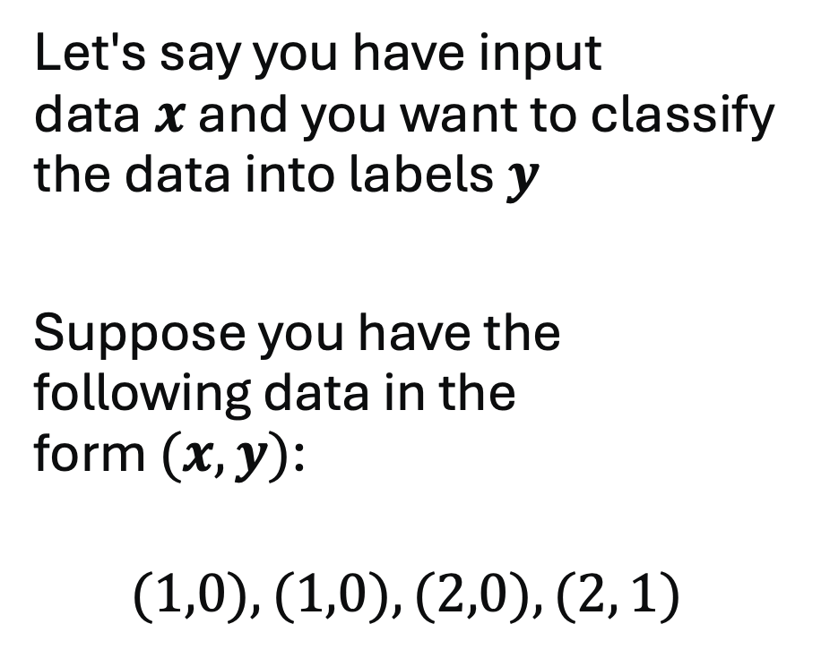
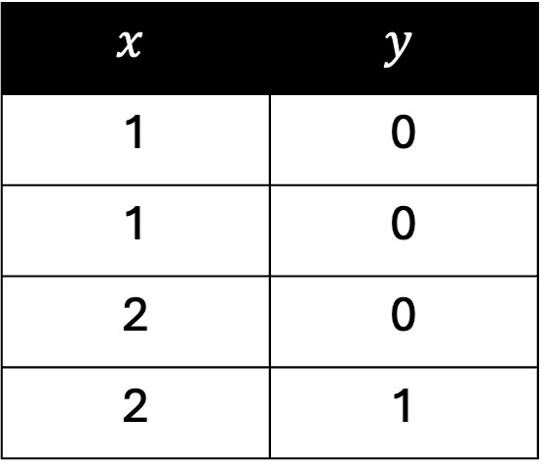
Example
Let's say you have input data $x$ and you want to classify the data into labels $y$
Suppose you have the following data in the form $(x,y)$:
$$(1,0), (1,0), (2,0), (2, 1)$$
$$x$$ | $$y$$
1 | 0
1 | 0
2 | 0
2 | 1

Slide 15

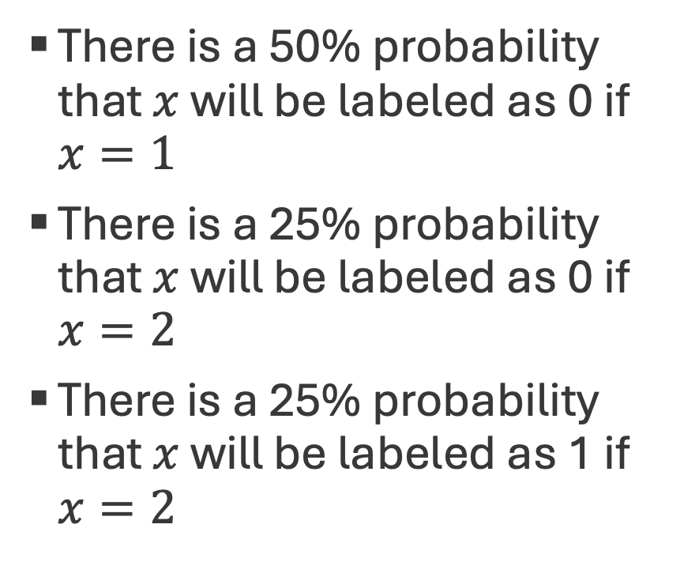
Joint Probability $P(x,y)$
There is a 50% probability that $x$ will be labeled as 0 if $x=1$
There is a 25% probability that $x$ will be labeled as 0 if $x=2$
There is a 25% probability that $x$ will be labeled as 1 if $x=2$
$$x$$ | $$y$$
1 | 0
1 | 0
2 | 0
2 | 1

Slide 16


Conditional Probability $P(y|x)$
There is a 100% probability that $x$ will be labeled as 0 if $x=1$
There is a 50% probability that $x$ will be labeled as 0 if $x=2$
There is a 50% probability that $x$ will be labeled as 1 if $x=2$
$$x$$ | $$y$$
1 | 0
1 | 0
2 | 0
2 | 1

